Slide 1
Palliative Care
Presented by:
Jaime Kiff, B.S.
Megan Guerre, M.S.
David Windler, M.D.

Slide 2
Do you have any experience with palliative care?

Slide 3
Outline
Case introduction
Definitions of palliative care
FAQ
Palliative care vs. hospice
Accessing palliative care
Palliative care & ovarian cancer

Slide 4
Case
Christine is a 58 year old woman recently diagnosed with ovarian cancer. Prior to her diagnosis, she worked as a physical therapist with cancer patients. She was concerned about the risk of COVID-19 exposure, but enjoyed her job and was initially able to continuing to work while receiving treatment. Eventually though, she was unable to continue working when the symptoms from her cancer and its treatment began to take its toll. She reported that “I could not even cross the street. I would look at other people moving so fast. Sometimes the light would change and I was not even finished crossing yet.” Christine also experienced worsening migraines, constipation, and nausea mostly related to the chemotherapy regimen that she was on.
Describing herself as a normally positive person, Christine reported that the pain was so overwhelming she felt herself going into a deep depression. This time was especially tough because she could not visit her daughter for support - due to the social distancing recommendations and desire to stay as safe as possible.³

Slide 5
Center to Advance Palliative Care (CAPC) definition
Palliative care is specialized health care for people living with a serious illness. This type of care is focused on providing relief from the symptoms and stress of the illness. The goal is to improve quality of life for both the patient and the family.
Provided by a specially-trained team, palliative care specialists work together with a patient’s other doctors to provide an extra layer of support. Palliative care is based on the needs of the patient, not on the patient’s prognosis. It is appropriate at any age and at any point in a serious illness and can be delivered with curative treatment.

Slide 6
World Health Organization (WHO) definition
Palliative care is an approach that improves the quality of life of patients and their families facing the problems associated with life-threatening illness, through the prevention and relief of suffering by means of early identification and impeccable assessment and treatment of pain and other problems, physical, psychosocial and spiritual. Palliative care:
Provides relief from pain and other distressing symptoms
Affirms life and regards dying as a normal process
Intends neither to hasten or postpone death
Integrates the psychological and spiritual aspects of patient care
Offers a support system to help patients live as actively as possible until death
Offers a support system to help the family cope during the patient’s illness and in their own bereavement
Uses a team approach to address the needs of patients and their families, including bereavement counselling, if indicated
Will enhance quality of life, and may also positively influence the course of illness
Is applicable early in the course of illness, in conjunction with other therapies that are intended to prolong life, such as chemotherapy or radiation therapy, and includes those investigations needed to better understand and manage distressing clinical complications¹²

Slide 7
Evidence-based care
In 2010, a randomized trial of patients with metastatic non-small cell lung cancer showed that those who received early consultation with palliative care specialists + standard oncologic care (e.g. chemotherapy/radiation therapy) not only had a higher quality of life by the end of the trial, but also survived 25% longer than those in the group receiving standard oncologic care alone⁶.
“As early as 2012, the American Society of Clinical Oncology (ASCO) recommended integration of palliative care into standard oncology care, particularly in patients with advanced, recurrent, and metastatic cancer.¹¹”
A 2018 review showed that palliative care has been demonstrated to improve quality of life, mood, and end-of-life care in 7 randomized trials, systematic reviews, and meta-analyses⁴.
The focus of 2020 seems to be improving access. Palliative care is being imbedded in cancer clinics, allowing the palliative care team to see patients at the same time as the oncology team. The electronic medical record has been used successfully to trigger palliative care consultations. Finally, clinics are working to provide palliative care training to staff and practitioners.¹⁴

Slide 8
COVID & palliative care
-Cancer treatment centers balancing patient and staff protection, preventing further spread of the virus, delivering cancer care, and ensuring access to acute care and to palliative and end-of-life care
-Stories of COVID-19 infection are a reminder of the importance of palliative care and that of human connection in the context of advanced disease
-Highlighted unequal access to healthcare
-Provided for new collaboration and technologies¹⁵

Slide 9
Who provides palliative care?
Palliative care is provided by a specially trained, interdisciplinary team of physicians, advanced practice registered nurses, physician assistants, nurses, social workers, chaplains, as well as the following professionals (based on need)¹:
Case managers
Community health workers
Massage, art, and music therapists
Mental health professionals
Nursing assistants
Nutritionists
Occupational therapists
Respiratory therapists
Paramedics & emergency medical technicians
Psychologists & psychiatric-mental health advanced practice registered nurses
Physical therapists
Speech and language pathologists
Traditional medicine practitioners⁸

Slide 10
Who receives palliative care? Is it right for me?
Anyone who would like help managing the symptoms and stress of serious illnesses, such as…
Cancer
Congestive heart failure (CHF)
Chronic obstructive pulmonary disease (COPD)
Kidney disease
Alzheimer’s
Parkinson’s
Amyotrophic Lateral Sclerosis (ALS)
...is eligible for palliative care.
Palliative care may be right for you if you suffer from pain, stress or other symptoms due to a serious illness. It can be provided at any stage of illness and along with treatment meant to cure you¹.

Slide 11
FAQ
Where do I receive palliative care?
Palliative care can be provided in a variety of settings including the hospital, outpatient clinic and at home.
Can I have curative treatment together with palliative care?
Yes, absolutely. Your treatment choices are up to you. You can have palliative care at the same time as treatment meant to cure you.
Who else, besides the patient, can benefit?
Patients as well as caregivers are the special focus. Your doctors and nurses benefit too, because they are bettering meeting your needs¹.

Slide 12
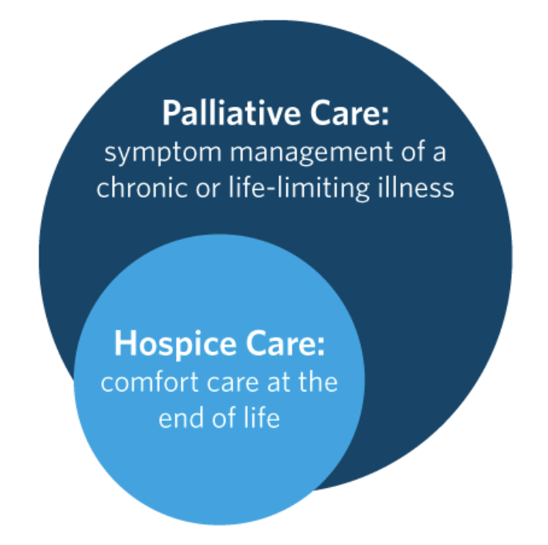
Origins of palliative care
Origins of palliative care, as a means to assist the severely ill, can be traced back to the middle ages
Officially, the first hospice (St. Christopher’s Hospice) was founded in London in the 1967
In the early 1970’s, the first palliative care unit in a modern hospital was opened in Montreal⁷
Hospice is a subset of palliative care
Share many similar goals with some differences

Slide 13
Palliative care vs. hospice
Focus
Relief of pain, symptoms and stress of serious illness
Complementary treatment completed in addition to primary curative care
Not time limited
Focuses on the pain, symptoms, and stress of serious illness during the terminal phase of an illness
An individual may access hospice care if they had a life expectancy of 6-months or less (assuming the disease runs its natural course)
Who can receive care
Hospice enrollment requires the individual has a terminal prognosis
Any individual with a serious illness, regardless of life expectancy or prognosis
How do my treatment goals help me decide which to pursue?
Hospice should be considered when the burden of curative treatment has begun to outweigh the benefit
Therefore, the patient must forgo treatments with curative intent when receiving hospice services
However, you can leave hospice any time you want and consider active treatment, if appropriate
Shared decision making
Can continue to receive curative treatment
Adapted from NHPCO “Palliative Care or Hospice” fact sheet.

Slide 14
Palliative care vs. hospice
Services provided
Pain and symptom management, in-person and telephonic visits, help navigating treatment options, advance care planning and referrals to community resources
24-hour on-call service, medical equipment, inpatient care, continuous care in the home, and respite care
Pain and symptom management, in-person visits, related medications, volunteer services, spiritual care, bereavement and counseling services.
Is it covered by Medicare?
The Medicare Hospice Benefit pays all related costs associated with the care that is related to the terminal prognosis
There may be some medications, services, and/or equipment that are not included in the Medicare Hospice Benefit
Palliative care is covered through Medicare Part B.
Some treatments and medications may not be covered.
May be subject to a co-pay according to the plan
Is it covered by private insurance?
Most private insurers have a hospice benefit that pays all related costs associated with the care related to the terminal prognosis.
Most private insurers include palliative care as a covered service
Adapted from NHPCO “Palliative Care or Hospice” fact sheet.
Notes:
Palliative care is covered through medicaid, but it is likely variable by state and some treatments and medications may not be covered.
Hospice: in most states Medicaid pays all related costs associated with the care related to the terminal prognosis, although some meds and treatments may not be covered.

Slide 15
How do I access palliative care?
Often requires a referral
Tell your nurse and oncologist you would like to see the palliative care team or ask for a recommendation
Provider Directory on GetPalliativeCare.org²
https://getpalliativecare.org/provider-directory/

Slide 16
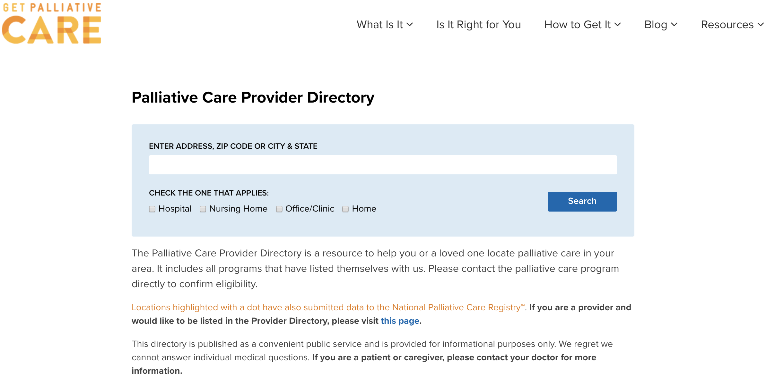
How do I access palliative care?

Slide 17
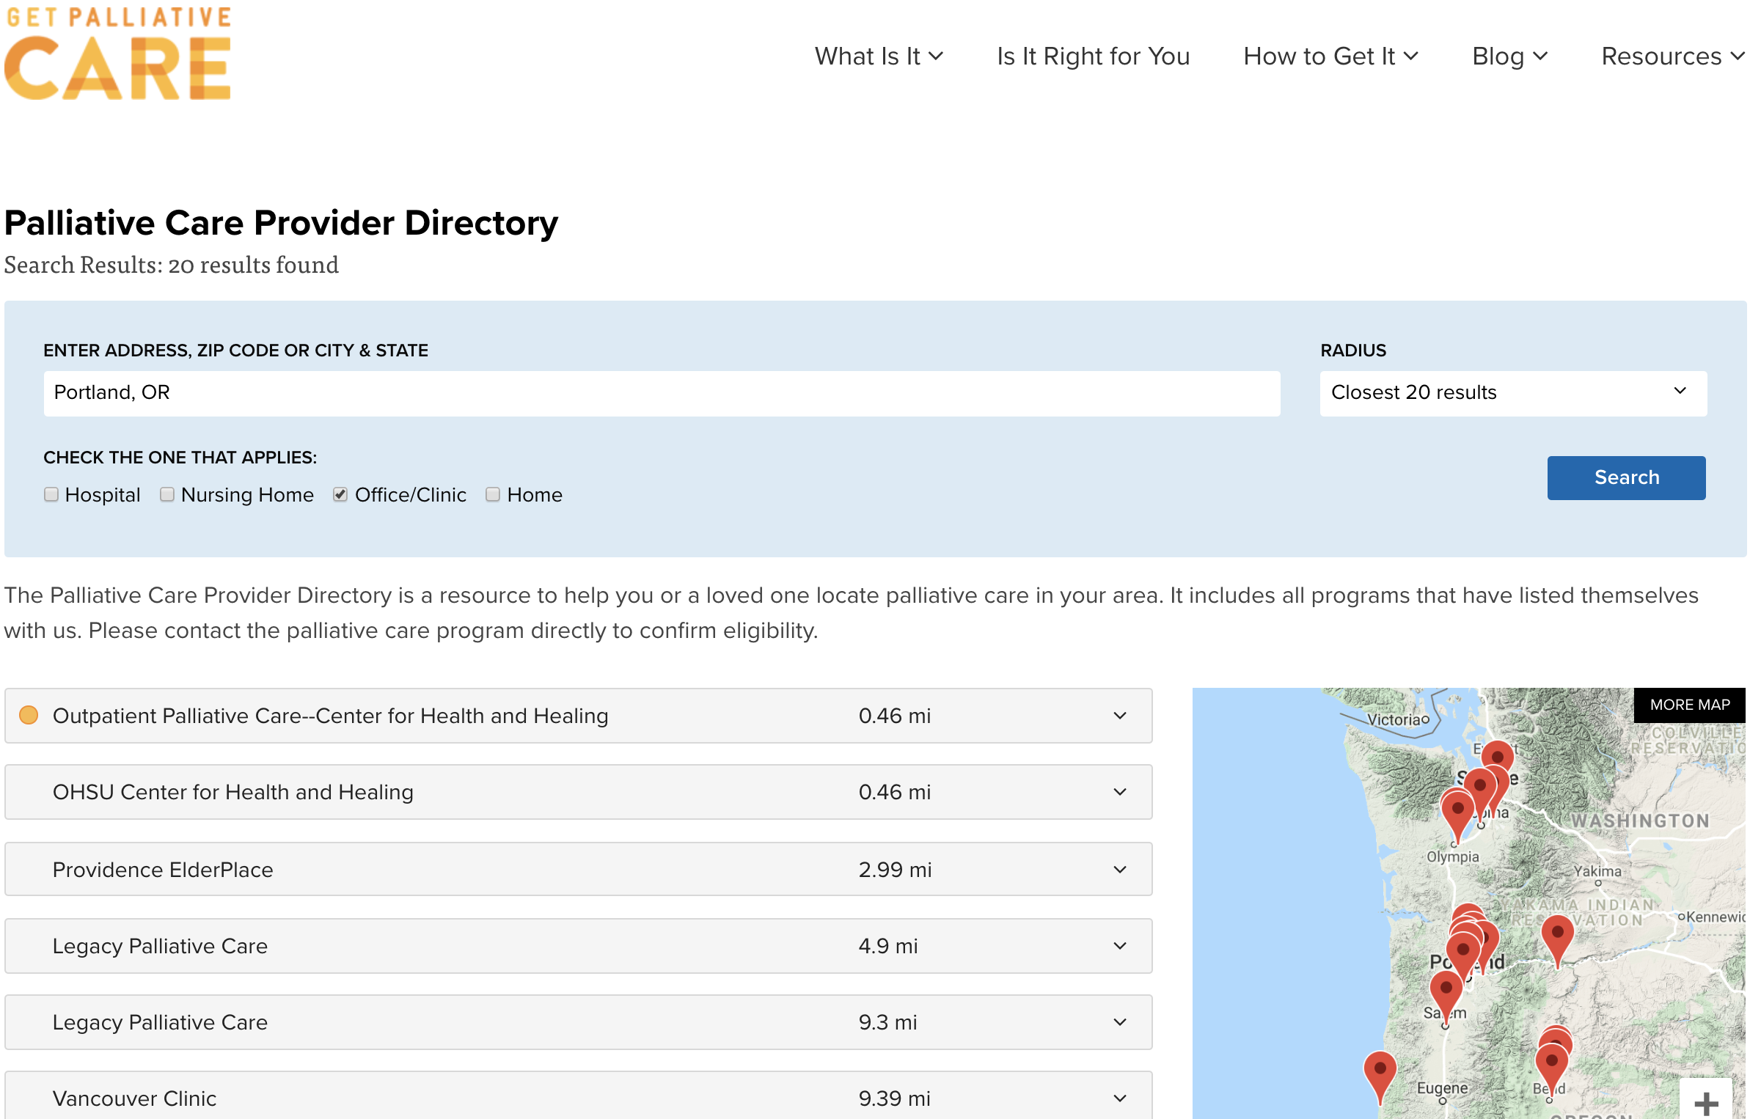
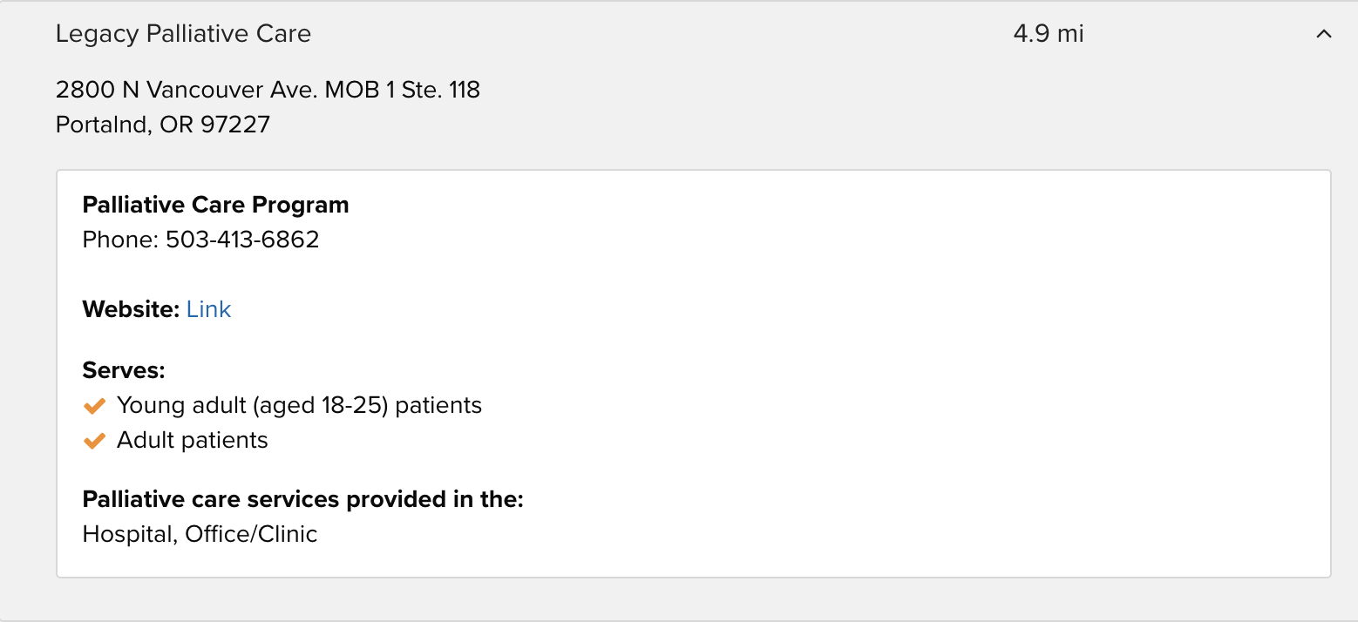
How do I access palliative care?

Slide 18
Case continued
Christine sought out palliative care for assistance managing her symptoms.
The team helped her manage side effects, develop coping skills and direct her treatment. They took time to walk Christine through each step so she could make the most informed decision regarding her care and to set goals. For her, returning to an active life was critical.
The palliative care team was able to make medication recommendations that got her symptoms and mobility limitations under better control, allowing her to take long walks in her neighborhood with her husband during the course of her chemotherapy regimen³.

Slide 19
Palliative Care & Ovarian Cancer
Any person, of any age, with any type or stage of cancer can benefit from palliative care—and the earlier, the better.

Slide 20
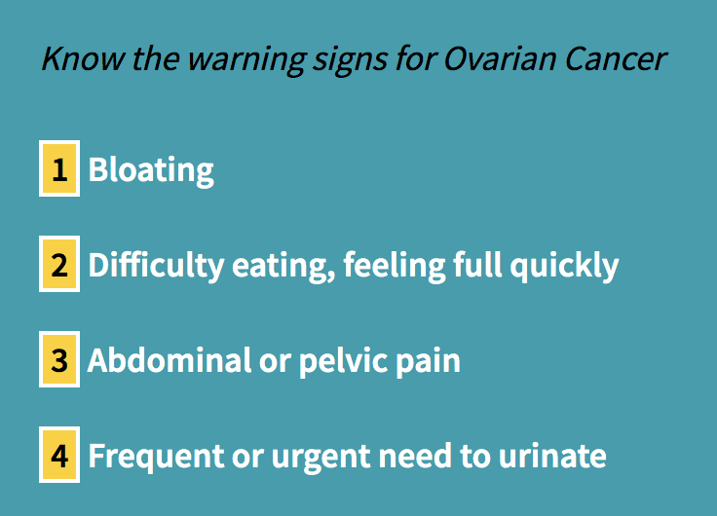
Palliative care & ovarian cancer
Examples of specific symptoms addressed
Fatigue
Bloating
Abdominal pain
Early satiety and poor appetite
Nausea, vomiting
Constipation, diarrhea
Urinary changes
Insomnia
Peripheral neuropathy
Shortness of breath
Malignant bowel obstruction (medical management)⁵

Slide 21
How can palliative care benefit you?
Palliative care services include:
Advocating for you and empowering you to advocate for yourself
Care coordination with your current physicians and anyone else who is part of your healthcare team
Assistance with the development of your individual and unique plan of care for the management of distressing symptoms
Help sorting out your immediate concerns and goals
Addressing functional limitations that impact daily activities and cognition
Exceptional pain and symptom management by specially trained doctors and nurses
Assessment of whether potential side effects can be treated preventatively

Slide 22
How can palliative care benefit you?
continued:
Spiritual care, if desired, as you and your family deal with the stress of your illness
Recognition and treatment of psychological issues (e.g. anxiety, depression, hopelessness)
Addressing nutritional needs and food insecurity
Addressing the effect of illness or injury on intimacy and sexual expression⁹
Practical help with the completion of insurance forms, and with making decisions about options for your care and/or housing
Completion of your advance directives so that your family and physicians are aware of the kind of care you want to receive (advance care planning is making decisions about the healthcare you would want to receive if you happen to become unable to speak for yourself. This information is contained in an advance directive)
Communicating with patients and families about signs and symptoms of approaching death, transitions of care, and grief and bereavement⁹

Slide 23
Questions to ask the palliative care team
What can I expect from palliative care?
Where will my care be provided (e.g., in the hospital, home, nursing home)?
Who is on the palliative care team?
What are your recommendations for my care?
What decisions need to be made by either my family or me?
Will you help explain my treatment choices and the issues involved in making these decisions?
Will you communicate openly and candidly with my family and me about my illness?
Will you continue to be involved in my care when I am in the hospital (if you are an outpatient).
Will you be involved in my care when I am discharged from the hospital or living at home?
How will you work with and communicate with all my other doctors?
What will you do if I experience severe pain or other symptoms?
What support will you provide to my family and/or caregivers?
Will you still be available to me throughout my illness?
How can I reach you?
What resources do you recommend for me to learn more about palliative care?

Slide 24
Case finale
Christine and her husband meet with a social worker to discuss the impact that cancer care and treatment is having on her and her husband. Christine’s connection to the social worker on her team played an integral role in her care and even provided much-needed support for Christine’s caregiver, her beloved husband. Spirituality is very important to Christine. She has been active in her faith community. Someone from the spiritual care services would often meet with her.
Reflecting on her experience, Christine reported that she could not imagine going through what she went through without palliative care as part of her team³.

Slide 25
The goal of palliative care…
“to cure sometimes, to relieve often, and to comfort always.”
Hippocrates¹³

Slide 26
Questions?
Megan Guerre: guerrem@ohsu.edu
Jaime Kiff: wrighjai@ohsu.edu
David Windler: david.windler@compassoncology.com

Slide 27
Resources/References
Aging, Disability, and Veterans Services Office - Washington county
-Offers services to caregivers
-Examples of services: information about available community services, Family Caregiver Training, paid respite care
https://www.co.washington.or.us/HHS/DAVS/Caregivers/services.cfm
Advance directive/POLST
-Conversation project: https://theconversationproject.org/
-State of Oregon advance directive: https://www.oregon.gov/oha/PH/ABOUT/Documents/Advance-Directive.pdf
-State of Washington advance directive: https://endoflifewa.org/advance-directive/
-Physician Orders for Life Sustaining Treatment (POLST) Washington: https://www.doh.wa.gov/YouandYourFamily/IllnessandDisease/PhysiciansOrdersforLifeSustainingTreatment
-Physician Orders for Life Sustaining Treatment (POLST) Oregon: https://oregonpolst.org/patientfamilyresources

Slide 28
Resources/References
Center to Advance Palliative Care. 2019. https://getpalliativecare.org/
Center to Advance Palliative Care. Provider directory. 2019. https://getpalliativecare.org/provider-directory/
Center to Advance Palliative Care. Living Well with Ovarian Cancer: Christine’s Palliative Care Story. 2015. https://getpalliativecare.org/living-well-with-ovarian-cancer-christines-palliative-care-story/
D. Miller & N. Nevadunsky. Palliative Care and Symptom Management for Women with Advanced Ovarian Cancer. Hematol Oncol Clin North Am. 2018; 32(6): 1087-1102. doi: 10.1016/j.hoc.2018.07.012
E. Loggers. (2019, July). Living with Ovarian Cancer: How Palliative Care Can Help. Presented at OCRA Ovarian Cancer National Conference, Seattle, WA.
J. Temel, et. al. Early Palliative Care for Patients with Metastatic Non–Small-Cell Lung Cancer. N Engl J Med 2010; 363: 733-742. DOI: 10.1056/NEJMoa1000678.
M. Stolberg (2017). A History of Palliative Care, 1500-1970. Philosophy and Medicine, vol 123. Springer, Cham.
National Consensus Project for Quality Palliative Care. Clinical Practice Guidelines for Quality Palliative Care, 4th edition. Richmond, VA: National Coalition for Hospice and Palliative Care; 2018. https://www.nationalcoalitionhpc.org/ncp.
National Hospice and Palliative Care Organization. 2019. https://www.nhpco.org/
National Hospice and Palliative Care Organization. Palliative care or hospice? Fact sheet. 2019. https://www.nhpco.org/wp-content/uploads/2019/04/PalliativeCare_VS_Hospice.pdf
T.J. Smith, et al. American Society of Clinical Oncology provisional clinical opinion: the integration of palliative care into standard oncology care. J Clin Oncol. 2012; 30(8): 880-887
World Health Organization. https://www.who.int/cancer/palliative/definition/en//
Available at: http://www.brainyquote.com/authors/hippocrates-quotes Accessed 11/12/2020.
Ferrell BR, Chung V, Koczywas M, Smith TJ. Dissemination and Implementation of Palliative Care in Oncology. J Clin Oncol. 2020;38(9):995-1001. doi:10.1200/JCO.18.01766, 10.1200/JCO.18.01766
Rodin G, Zimmermann C, Rodin D, Al-Awamer A, Sullivan R, Chamberlain C. COVID-19, palliative care and public health. Eur J Cancer. 2020;136:95-98. doi:10.1016/j.ejca.2020.05.023, 10.1016/j.ejca.2020.05.023

