Slide 1
Annual ovarian cancer genetics update
Ovarian Cancer Alliance Update meeting
June 23, 2020
Becky Clark, MS, CGC
Genetic Counselor
Genetic Risk Evaluation & Testing Program

Slide 2
What is a genetic counselor?
Learn more at http://www.aboutgeneticcounselors.com/

Slide 3
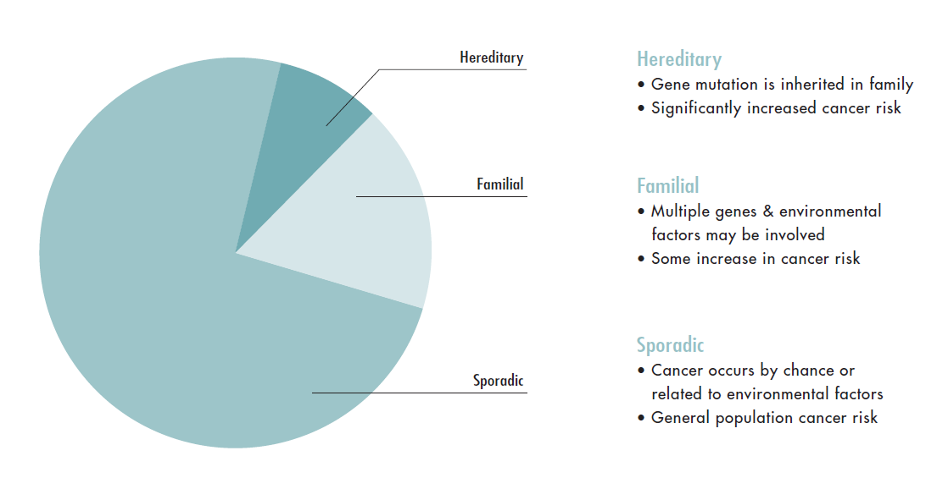
5-10%
15-20%
80%
Notes:
Counseling Notes
Sporadic Cancer - Most cancer occurs by change, this is often called sporadic cancer. People with sporadic cancer do not typically have relatives with the same type of cancer.
Familial cancer – Cancer likely caused by a combination of genetic and environmental risk factors. People with familial cancer may have relatives with the same type of cancer; but, there doesn’t appear to be a specific inheritance patter (example: cancer not clearly passed from parent to child).
Hereditary Cancer – Cancer that is caused by a change in a gene that is passed down through the family from parent to child. Individuals with Hereditary cancer are more likely to have relatives with the same type of cancer or related types of cancer. They typically develop cancer at younger ages and may often have more than one cancer.
It is important to determine which families have a hereditary from of cancer because these families have much higher cancer risks and should follow different medical management guidelines

Slide 4
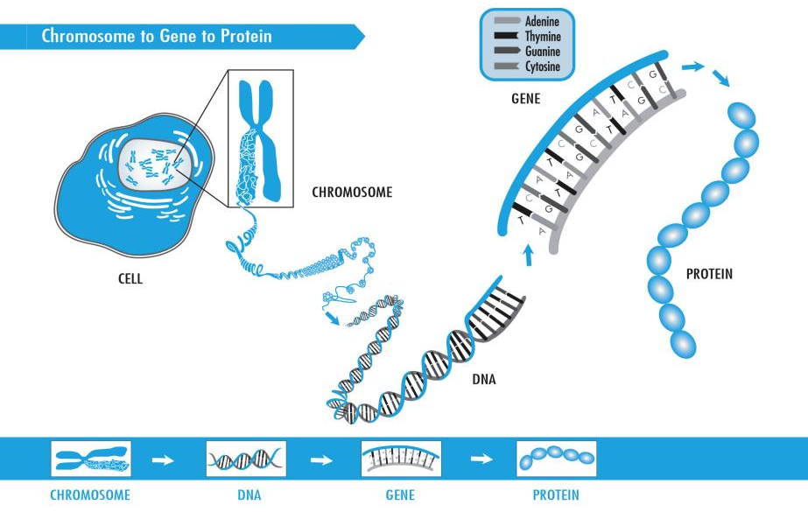

Slide 5
The genetics iceberg
-------How cancer works
----------------------Targeted therapies
----------------------Personalized cancer risk
Who benefits from increased screening/prevention?

Slide 7
Somatic/

Slide 9
Multi-cancer panels: multiple genes for multiple cancer types
Cancer Panel: Multiple genes focused on a cancer type
Negative for BRCA/Lynch in the past? You are eligible for updated testing​
Single gene/syndrome
Targeted mutation

Slide 10
…for only 3 of the 1,000s of possible mutations in only the BRCA genes.
Targeted mutation

Slide 11
Who should consider genetic testing? (A brief overview)
Personal or family history of:
Young age at onset (for that cancer type)
ie Breast < age 45, Colon < age 50
A personal history of more than one primary cancer
A family history of multiple individuals with cancer
2 or more family members with the same or related types of cancer
ie Breast/Ovarian; Colon/Uterine; Breast/Sarcoma/Brain
Rare cancer
Such as ovarian or male breast
A known gene mutation in the family
For treatment: ovarian, breast, pancreatic,
metastatic prostate

Slide 12
What happens after genetic testing?
Younger age to start
Screening
More frequent screening
and prevention
More options
Cancer risk for children, siblings, etc.
Testing family
Possible reassurance about risk
Somatic or germline testing
Targeted treatment
PARP Inhibitors
Keytruda

Slide 13
Breast, male breast, prostate
Breast, male breast, prostate, pancreatic, melanoma
Prevention
Breast, colon, stomach, small intestine, pancreas, testes, lung
Colon, uterine, prostate, stomach, hepatobiliary, urinary, small bowel, brain/CNS, pancreas

Slide 14
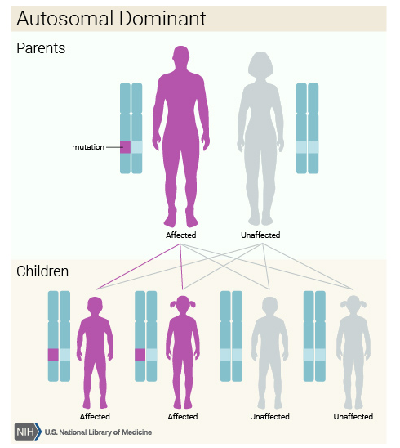
Testing family

Slide 15
Family history of cancer? Who is the best person to test?
Courtesy of Kallie Woods, MS, CGC

Slide 16
Targeted treatment
BRCA
PARP
Inhibitors
Thanks to Dr. Lisa McCluskey for this concept!

Slide 17
Types of results from genetic testing
Negative: no mutation detected
Base cancer risks on family history
Positive: mutation detected that causes an increased risk for cancer
Follow management guidelines for care
Offer genetic testing to other family members
Variant of uncertain significance (VUS):
Change identified, but not enough evidence to determine if disease causing or benign. Will be reclassified over time
Identified in 30% or more of patients testing on panels
Do not test family members. Exception: Research study
Base cancer risks on family history

Slide 18
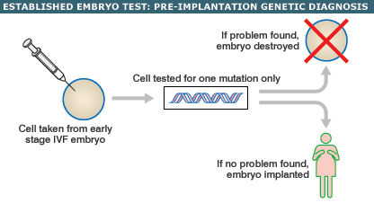
Thinking about the future
DNA banking
Store DNA at a facility for future testing
Fertility preservation and family planning
Freezing eggs
Donor eggs
Pre-implantation Genetic Diagnosis (PGD)
http://news.bbc.co.uk/2/hi/health/5079802.stm
Notes:
Image: http://news.bbc.co.uk/2/hi/health/5079802.stm

Slide 19
Perceived barriers to genetic testing
“My insurance won’t cover it / testing is too expensive”
Most payers support genetic testing if you meet criteria (even if you don’t have cancer yourself)
For underinsured/uninsured patients, financial assistance and reduced OOP rates are available
Labs try to be up front about cost and limit financial surprises
“I’m worried about insurance discrimination”
Genetic Information Nondiscrimination Act (2008)
Oregon State genetics privacy law (2006)
“Test results won’t change what I’m doing”
True in few cases
A positive result may lead to increased or additional screening, options for prevention
A negative result may reduce current screening
Impact on risk to family members

Slide 20
Resources
Ovarian Cancer Alliance of Oregon and Southwest Washington
www.ovariancancerosw.org/
Sherie Hildrith Ovarian Cancer Foundation
www.shocfoundation.org/
FORCE (ovarian cancer page)
http://www.facingourrisk.org/understanding-brca-and-hboc/KNOW-MORE.php
National Society of Genetic Counselors (to find a genetic counselor)
www.NSGC.org/

Slide 21
Questions?
Genetic Risk Evaluation And Testing Program (GREAT)
Call to schedule an evaluation:
503-297-7403

